Slide 1
Lightweight Emulation of Virtual Channels using Swaps
NocArc 2017
Mayank Parasar and Tushar Krishna
School of Electrical and Computer Engineering
Georgia Institute of Technology
synergy.ece.gatech.edu
mparasar3@gatech.edu

Slide 2
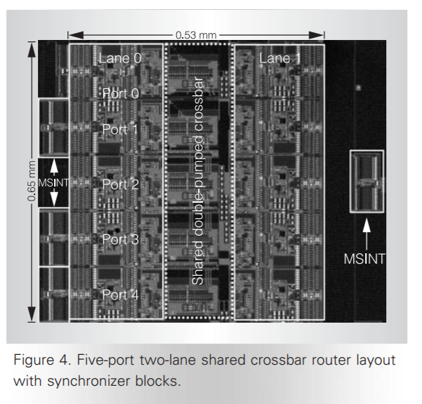
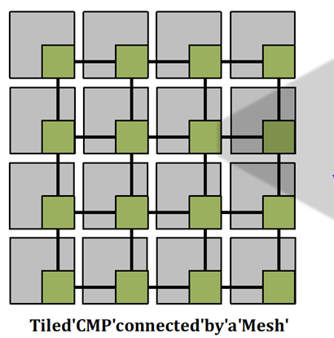
Motivation: Buffer Management
Core
North
Control
West
Xbar
East
Buffers
Router
South
Manage contention
Avoid deadlocks
Buffers are key component in any NoC router
Source: Intel Teraflops, IEEE Micro 2007
Notes:
Talk:
This is an overview image and it shows
How the cores are connected to each other in the modern CMPs
Using Mesh topology. Each node (core)here is connected to router
Which in turn is connected to other neighbouring nodes and core itself
Coming to the motivation of the talk ‘why should we need buffers at all in the topology’
It is mainly because of the following reasons:
1. Simultaneous request for the same output port can’t leave.. They need to be sequentialized therefore the other request need to be stored somewhere within the router
2. There could be difference of rated (sporadic-ness within network) of rate at which requests are producing to the rate at which it is getting consumed
3. <ask Tushar for other reasons>
The problem of buffer management gets exaggerated by having buffers at many logical level..
As explained in this slide…
buffers needed at ‘virtual network’ level
Virtual Network => Request; Response
Why do we need buffers at all…
They are required for managing multiple request over shared link..

Slide 3
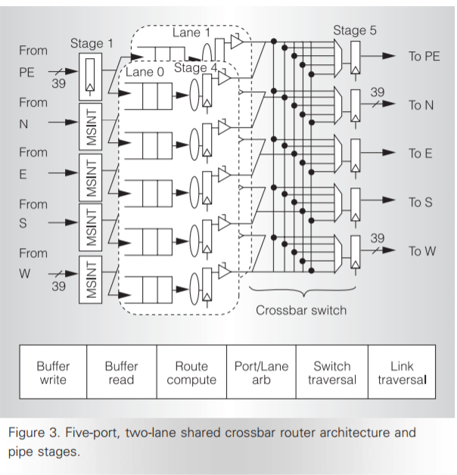
Flow Control
Flow Control options
Message-based Flow Control
E.g., Circuit Switching
Packet-based Flow Control
E.g., Store and Forward, Virtual Cut-Through
Flit-based Flow Control
E.g., Wormhole, Virtual Channel
Most popular for on-chip networks

Slide 4
Wormhole Flow Control Example
Red holds this channel: channel remains idle until red proceeds
Channel idle but red packet blocked behind blue
6 flit buffers/input port
Dest for Red
Buffer full: blue cannot proceed
Blocked by other packets
“Head-of-Line Blocking”
Dest for Blue

Slide 5
Wormhole Flow Control
Pros
More efficient buffer utilization (good for on-chip)
Low latency
Cons
Poor link utilization: if head flit becomes blocked, all links spanning length of packet are idle
Cannot be re-allocated to different packet
Suffers from head of line (HOL) blocking

Slide 6
Virtual Channel Flow Control Example
6 flit buffers/input port
3 flit buffers/VC
Dest for Red
Buffer full: blue cannot proceed
Blocked by other packets
Dest for Blue

Slide 7
Deep VC - Shallow VC
Deep Virtual Channels
Shallow Virtual Channels
Control
^{Equal buffers}
Control
Xbar
Xbar
Buffers
Buffers
Buffers
Buffers
Router
Router
N
Are Virtual Channels always better?
E
W
S

Slide 8
Motivation: Pros and Cons

Slide 9


Pros and Cons
 |  | Wormhole | Shallow VC | Intermediate VC | Deep VC
 | Area
 | Power
Single flit Packet | Latency
 | Throughput
Multi flit Packet | Latency
 | Throughput

Slide 10
Big Question
Can we have performance of VCs at the cost of wormhole!?
Notes:
The big question

Slide 11
Outline
Motivation
Enter SwapNoC
SwapNoC Policies
Tail_Swap
Credit_Swap
Random_Swap
Comparision to VCs
Evaluation and Results
Conclusion

Slide 12
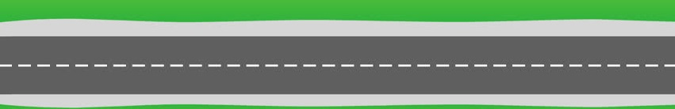




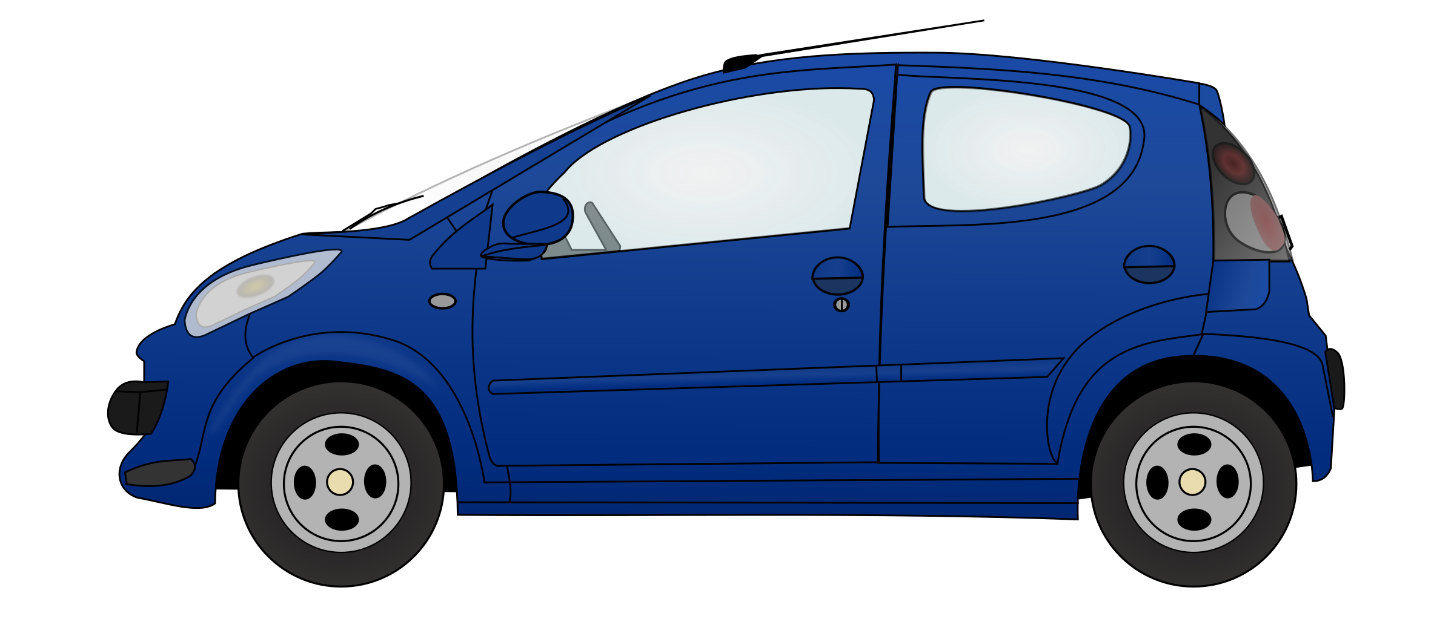

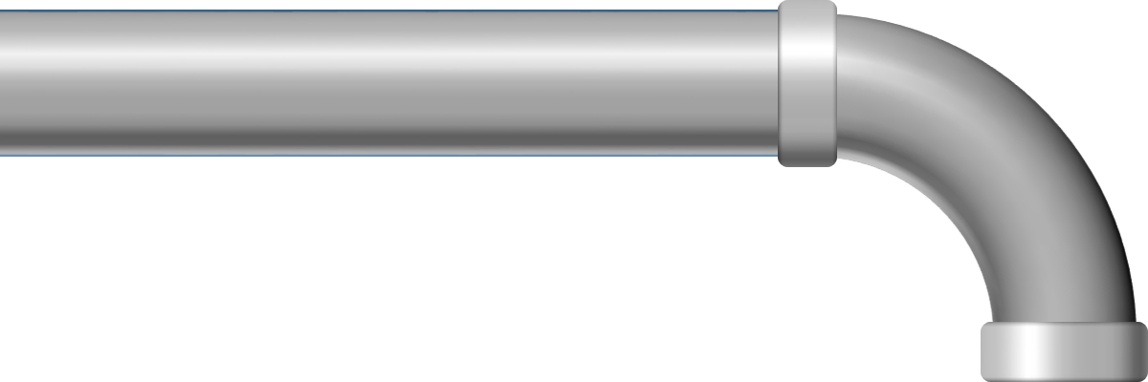
Highlevel Idea
Wormhole
Virtual Channel
Can we use same inspiration in NOC!?
SwapNoC
This Photo by Unknown Author is licensed under CC BY-NC

Slide 13
Swaps
Software swap vs Hardware swap
Software Swap
Hardware Swap
a
b
a
b
tmp
clk
// using tmp variable
tmp = a;
a = b;
b = tmp;
// parallel assignment
a <= b;
b <= a;

Slide 14

MicroArc
Physical
Link
Core
North
Decided by the policy
!(Swap)
Swap
Swap
0
1
Qhead
West
Xbar
East
1
Qtail
Router
South
Analogous to circular
Shift register
clk

Slide 15
Quick Recap

Slide 16
Outline
Motivation
Background
Enter SwapNoC
SwapNoC Policies
Tail_Swap
Credit_Swap
Random_Swap
Comparison to VCs
Evaluation and Results
Conclusion

Slide 17

Tail_Swap
Core
North
4
S
N
N
S
E
E
N
N
West
Xbar
East
Router
South

Slide 18
Outline
Motivation
Background
Enter SwapNoC
SwapNoC Policies
Tail_Swap
Credit_Swap
Random_Swap
Comparison to VCs
Evaluation and Results
Conclusion

Slide 19
Credit_Swap
free Slots at
local port
free Slots at
down stream’s
South port
3
0
Core
North
S
N
N
S
E
E
N
N
West
Xbar
East
2
1
Router
0
South
free Slots at
down stream’s
West port
free Slots at
down stream’s
North port

Slide 20
Outline
Motivation
Background
Enter SwapNoC
SwapNoC Policies
Tail_Swap
Credit_Swap
Random_Swap
Comparison to VCs
Evaluation and Results
Conclusion

Slide 21
Random_Swap
S
Core
North
West
S
N
Xbar
N
East
Router
South
Random swap
N
E

Slide 22
Outline
Motivation
Background
Enter SwapNoC
SwapNoC Policies
Tail_Swap
Credit_Swap
Random_Swap
Comparision to VCs
Evaluation and Results
Conclusion

Slide 23
Comparison to VCs
How to emulate shallow VCs with SwapNoC
N
Frequent swaps
to emulate shallow VCs
S
N
E
N
E
SwapNoC
N
North blocked!
S
Shallow VCs
How to emulate deep VCs with SwapNoC
occasional swaps
to emulate deep VCs
N
N
S
N
E
N
E
S
SwapNoC
Deep VCs

Slide 24
Outline
Motivation
Background
Enter SwapNoC
SwapNoC Policies
Tail_Swap
Credit_Swap
Random_Swap
Comparision to VCs
Evaluation and Results
Conclusion

Slide 25
Area and Power
SwapNoC is 2x smaller in area and comsumes 2x lesser power compared to VC routers

Slide 26
Overhead over baseline
Physical
Link
Core
North
0
1
Qhead
West
Xbar
East
!(Swap)
1
Qtail
Router
Swap
Swap
South
SwapNoC increases critical path by 8.4-9.4%
Adds 8% area and 1% power overhead over baseline wormhole routers

Slide 27
Revisiting comparison Metric
 |  | Wormhole | Shallow VC | Intermediate VC | Deep VC | Swap-NoC
 | Area
 | Power
Single flit Packet | Latency
 | Throughput
Multi flit Packet | Latency
 | Throughput

Slide 28
Simulation Configuration
Network Configuration
Wormhole | Wormhole router with a N-flit deep queue
VC-Shallow | N 1-flit VCs (max number of VCs)
VC-deep | 2 N/2-flit deep and 4 N/4-flit deep VCs
SwapNoC | N-flit deep queue with Swaps
Simulation Infrastructure
Network-topology | 64 nodes in 8x8 Mesh
Technology node | 15nm PDK
Simulator | Garnet Network, gem5 simulator
Memory model | Ruby

Slide 29
Performance with Synthetic Traffic - I
Multi-flit Packet (5 flit = 1 packet)
SwapNoC provides 80% improvement in throughput on average

Slide 30
Performance with Synthetic Traffic - II
Single-flit Packet (1 flit = 1 packet)
SwapNoC provides about 15% improvement in throughput over wormhole and provide 40-50% more throughput over deep-VCs in edge_50 and bit_rotation

Slide 31
Full System simulation Result
36 % reduction in runtime over both VCs and wormhole using credit_swap and random_swap

Slide 32
Outline
Motivation
Background
Enter SwapNoC
SwapNoC Policies
Tail_Swap
Credit_Swap
Random_Swap
Comparision to VCs
Evaluation and Results
Conclusion

Slide 33
Conclusion
Questions
Wormhole routers are area and power efficient but don’t give high performance
VCs are good for performance but comes with overhead of area and power
VC routers have more timing critical path than wormhole
SwapNoC marries the benefit of wormhole router with performance of VCs at modest area and power cost.
Thank you!

